Slide 1
Introduction to python 03
COTM5284

Slide 2
def names():
print("About the function")
names()
Functions
….to display data
def names(fn,sn): print(fn) print(sn) names('Abebe','Kebede')

Slide 3
def add(x,y): total=x+y return total print(add(100,150))
Functions
…to return value
def div(x,y): result=x/y return result print(div(10,5))
def subtract(x,y): result=x-y return result print(subtract(100,150))
def salary(a,r,t): result=a*(r+1)**t return result print(salary(5000,0.06,10))
def calc(x): result=x**2+5*x+5 return result print(calc(0))

Slide 4
def cube(x): result=x**3 return result n=float(input("enter the number:")) print(cube(n))
Functions
…to return value
def cuberoot(x): result=x**(1/3) return result n=float(input("enter the number:")) print(cuberoot(n))

Slide 5
About Class and inheritance in python, GUI in python and executable files in python. Furthermore watch the Video segment on creating exe files from python.
Reading assignment for next week:

Slide 6
Class and class instance
class Animal(): def insert(self,type,age,Category): self.type=type self.age=age self.Category=Category def output(self): print("animal type is "+ self.type + " ,animal age is " + self.age + " ,animal category is " + self.Category) #class is created d=Animal() d.insert("dog", "3", "carnivores") d.output() #class instance (object) is created
Class and inheritance in python:

Slide 7
Constructor __init__(self) function
class Animal(): def __init__(self, type, age, Category): self.type=type self.age=age self.Category=Category def output(self): print("Animal type is " + self.type + ", animal age is " + self.age + \ " and animal Category is " + self.Category) d=Animal('dog', '3','carnivores') d.output()
Class and inheritance in python:

Slide 8
To access variables and functions of an object use ‘.’
print(d.type) print(d.age) print(d.Category) print(d.output())
Class and inheritance in python:
Create multiple instances of a class
d=Animal('dog', '3','carnivores') c=Animal('caw', '5' , 'herbivores') h=Animal('horse', '3','herbivores') d.output() c.output() h.output()

Slide 9
Class and inheritance in python:
Class inheritance
class Animal(): def __init__(self, type, age, Category): self.type=type self.age=age self.Category=Category def output(self): print("Animal type is " + self.type + ", animal age is " + self.age + \ " and animal Category is " + self.Category) d=Animal('dog', '3','carnivores') d.output() class Offspring(Animal): pass p=Offspring('pup', '1','carnivores') p.output() | class Animal(): def __init__(self, type, age, Category): self.type=type self.age=age self.Category=Category def output(self): print("Animal type is " + self.type + ", animal age is " + self.age + \ " and animal Category is " + self.Category) class Female(): def nurturing(self): print("Female are nurturing!") class Offspring(Animal, Female): pass p=Offspring('pup', '1','carnivores') p.output() p.nurturing()

Slide 10
import math class Circle(): def insert(self,r): self.r=float(r) def output(self): print(math.pi*self.r**2) a=Circle() a.insert(5) a.output()
import math class Circle(): def __init__(self,r): self.r=float(r) def output(self): print(math.pi*self.r**2) a=Circle(5) a.output()
#Class instance creation with constructor.
Class and inheritance in python:

Slide 11
class Salary(): def __init__(self,a, r, t): self.a=float(a) self.r=float(r) self.t=float(t) def output(self): print(self.a*(self.r+1)**self.t)
k=Salary(5000, 0.06, 10) k.output()
class Salary(): def __init__(self,a, r, t): self.a=float(a) self.r=float(r) self.t=float(t) def output(self): print(self.a*(self.r+1)**self.t) class Secretary(Salary): pass k0=Secretary(4000,0.06,10) k0.output() k=Salary(5000, 0.06, 10) k.output()
Class and inheritance in python:

Slide 12
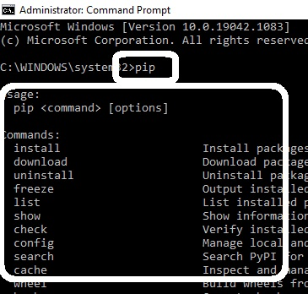
Make sure pip is installed on your computer. To check if pip is installed on your computer go to CMD and run it as administrator and then type pip as indicated on the image below:
Create executable file from python:
If you did not get an error it means you have installed pip on your computer and you have also added python to your environment variables path.
If you get error on CMD, add python to your environment variables path as showed to you at the beginning of this course. If that does not work re-install python with pip activated and path added to environment variables.

Slide 13
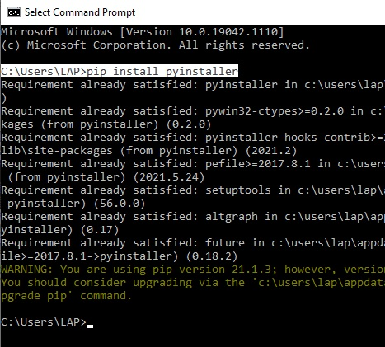
Create executable file from python:
…after you are done with the above step, you can go and you can install pyinstaller form your CMD as indicated below by typing pip install pyinstaller
In your cmd environment:

Slide 14
Create executable file from python:
…after you are done with the above step, you can go and you can start creating your executable file through the following steps:
type path of the .py file in cmd ( cd path… )
Type the command
(pyinstaller –onefile –w program.py)
The above steps will create an executable file in your project folder among with other files and folders. Your interest folder is the ‘dist’ folder. Rename this folder to your liking and zip it for further steps…
To further create installable .exe file, you can install NSIS software and from there by making use of installer based on zip file service, you can create the installable .exe file on your computer. Once you have the .exe file, you can share it.

Slide 15
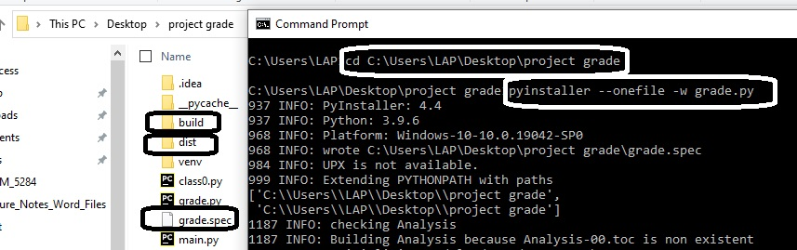
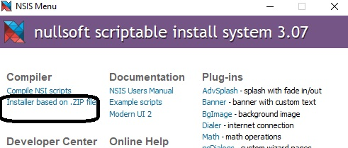
Create executable file from python:
…related images.
CMD
Windows explorer
NSIS

